Slide 1


Mobile Human Computer Interaction I
Predictive one finger text input
Johann Albach, Sebastian Hartwig, Kaith Menken, Daniel Eischer

Slide 2
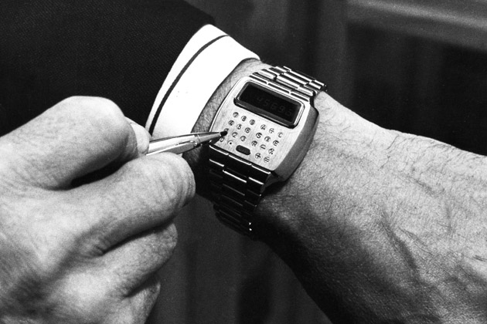
Technology yesterday

Slide 3
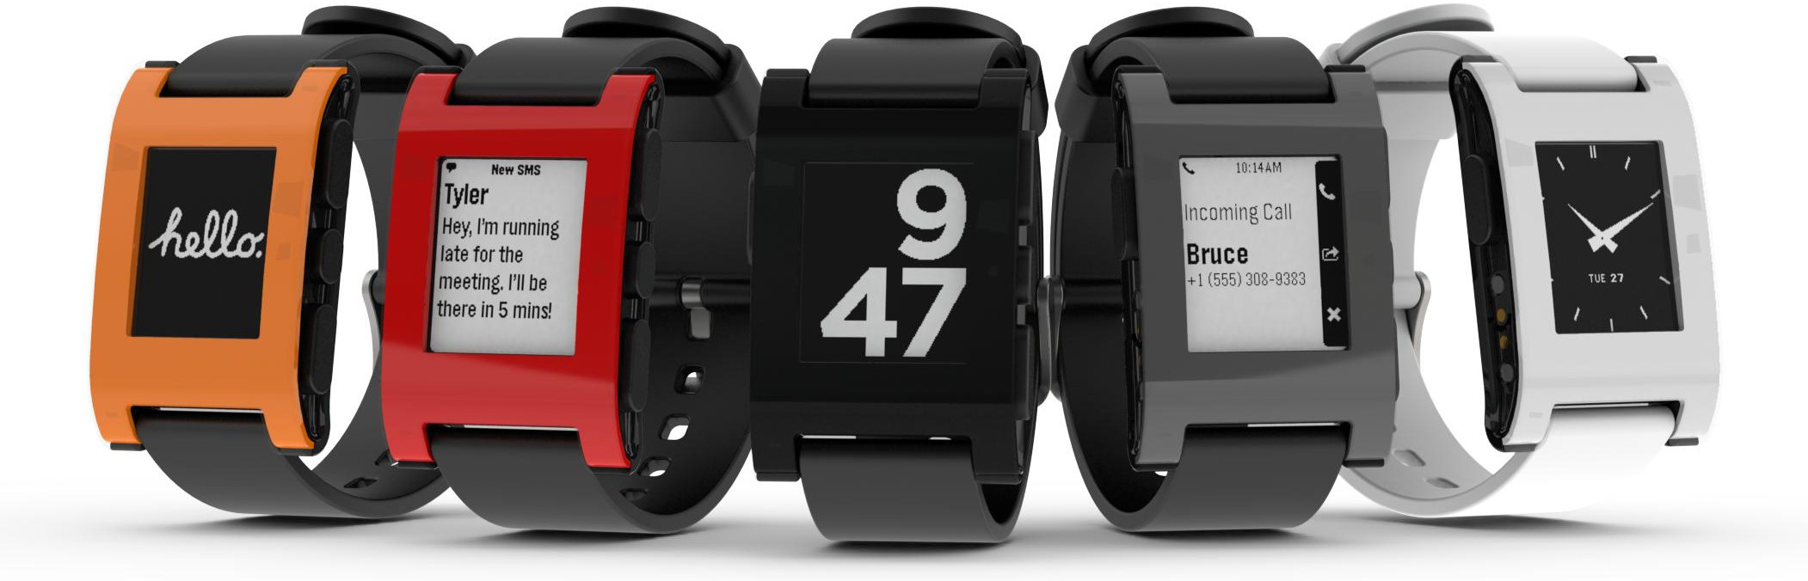
Technology today

Slide 4
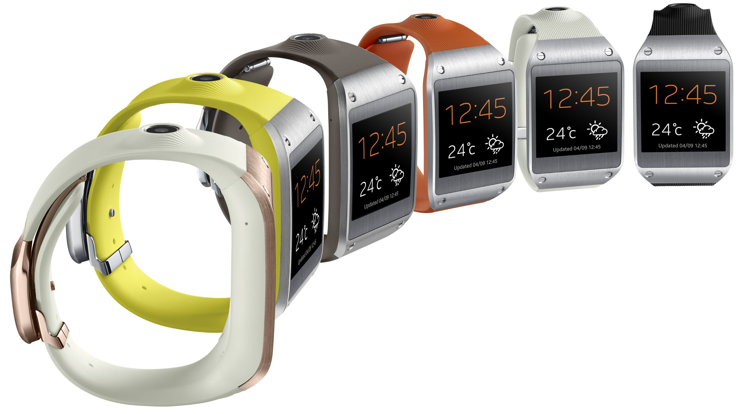
Technology today

Slide 5
T o d aayayyya

Slide 6
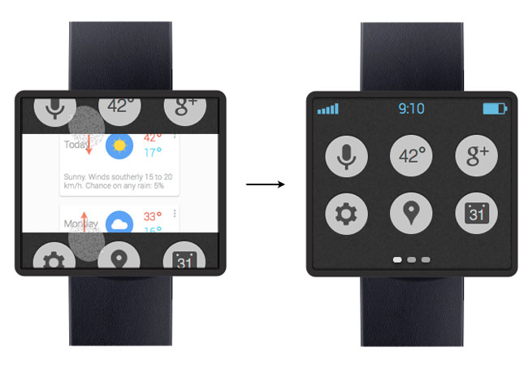
A glimpse into the future

Slide 7
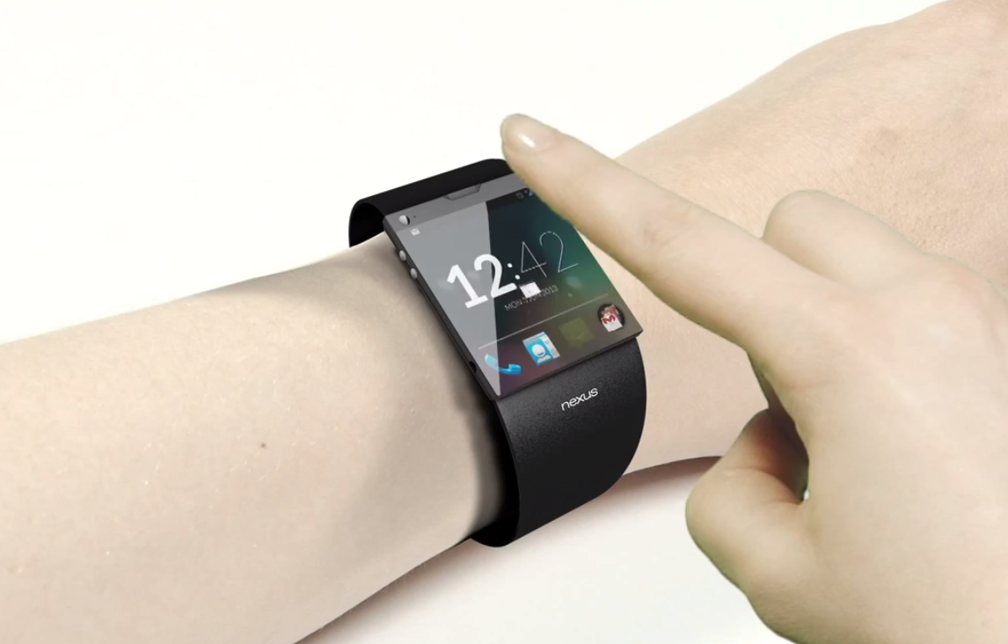
A glimpse into the future

Slide 8
A glimpse into the future

Slide 9
Our idea (Introduction)

Slide 10
The concept
Single handed

Slide 11
Key features

Slide 12
Key features

Slide 13
Key features

Slide 14
Key features

Slide 15
Key features

Slide 16
Implementation

Slide 17
Sources
http://philmckinney.com/wp/wp-content/uploads/2012/03/iStock_000016662401Medium.jpg
http://images.bwbx.io/cms/2013-01-28/0128_GWatch_630x420.jpg
http://www.technobuffalo.com/wp-content/uploads/2013/03/Google-Smartwatch-Concept.jpg

